Slide 1



Slide 2

PROJECT :Scalable Enterprise Network Design
Team Members:
M.DANIAL 233588
MUSA BIN ABDULLAH 233576
AMMAR YAQUB 233550

Slide 3





Introduction to Jackson Company Network Infrastructure
Comprehensive Design
Network infrastructure design and configuration for Jackson Company's branches in Sydney, Melbourne, Brisbane, and Hong Kong.
Security & Efficiency
VLAN segmentation, VLSM subnetting, DHCP, OSPF routing, ACL firewalls, and device hardening for optimal security and performance.
Integrated Services
Internal servers for DNS/HTTP, wireless access points, and VoIP integration ensure seamless communication and operations.
Rigorous Testing
Final testing using simulation tools validates the design's effectiveness and reliability.

Slide 4

VLAN Design and Subnetting for Sydney Branch
VLAN
Department
Subnet
Gateway
10
HR
188.88.0.0/21
188.88.0.1
20
IT
188.88.8.0/21
188.88.8.1
30
Finance
188.88.20.0/21
188.88.20.1
40
Admin
188.88.16.0/22
188.88.16.1
50
Servers
188.88.36.0/25
188.88.36.1
60
Guest WiFi
188.88.32.0/21
188.88.32.1

Slide 5
VLAN Design and Subnetting for Melbourne & Brisbane
Branches
Melbourne Branch
Brisbane Branch
VLAN
Department
Subnet
Gateway
VLAN
Department
Subnet
Gateway
10
HR
188.88.64.0/19
188.88.64.1
10
HR
188.88.76.0/20
188.88.76.1
20
IT
188.88.96.0/23
188.88.96.1
20
IT
188.88.80.0/23
188.88.80.1
30
Finance
188.88.98.0/23
188.88.98.1
30
Finance
188.88.82.0/23
188.88.82.1
40
Admin
188.88.100.0/23
188.88.100.1
40
Admin
188.88.84.0/23
188.88.84.1
50
Servers
188.88.102.0/25
188.88.102.1
50
Servers
188.88.86.0/25
188.88.86.1
60
Guest WiFi
188.88.104.0/23
188.88.104.1
60
Guest WiFi
188.88.88.0/23
188.88.88.1

Slide 6
VLAN Design and Subnetting for Hong Kong
Branch
HR (VLAN 10)
IT (VLAN 20)
Subnet: 188.88.96.0/23, Gateway: 188.88.96.1
Subnet: 188.88.100.0/23, Gateway: 188.88.100.1
Finance (VLAN 30)
Admin (VLAN 40)
Subnet: 188.88.102.0/23, Gateway: 188.88.102.1
Subnet: 188.88.104.0/23, Gateway: 188.88.104.1
Servers (VLAN 50)
Guest WiFi (VLAN 60)
Subnet: 188.91.36.0/25, Gateway: 188.91.36.1
Subnet: 188.88.108.0/23, Gateway: 188.88.108.1

Slide 7




DHCP and Internal Server Configuration
DHCP Services
DNS Server IPs
Core Servers
Enabled on all client-facing VLANs using Layer 3 switches, with static reservations for servers.
Sydney: 188.88.36.12, Melbourne: 188.88.64.12, Brisbane: 188.88.90.12, Hong Kong: 188.88.106.12.
Each branch hosts 6 core servers on VLAN 50, including DNS, HTTP, FTP, Mail, Database, and Backup servers.

Slide 8

Internal Server IP Addresses by Service
Service
Sydney
Melbourne
Brisbane
Hong Kong
DNS Server
188.88.36.12
188.88.102.12
188.88.90.12
188.91.36.12
HTTP Server
188.88.36.11
188.88.102.11
188.88.90.11
188.91.36.11
FTP Server
188.88.36.13
188.88.102.13
188.88.90.13
188.91.36.13
Mail Server
188.88.36.14
188.88.102.14
188.88.90.14
188.91.36.14
Database Server
188.88.36.15
188.88.102.15
188.88.90.15
188.91.36.15
Backup Server
188.88.36.16
188.88.102.16
188.88.90.16
188.91.36.16

Slide 9




Routing Configuration and ACL Firewall Rules
OSPF Dynamic Routing
All routers utilize OSPF for efficient and dynamic routing across the network, ensuring optimal data paths.
ACL Firewall Rules
Access-list rules are applied to Server VLANs to restrict unauthorized access, particularly from Guest VLANs, enhancing security.
Example: Sydney ACL
The SERVERS_PROTECT ACL denies IP traffic from the Guest WiFi subnet (188.88.32.0/21) to the Server subnet (188.88.36.0/25).

Slide 10










Device Security Hardening
Enable Secret
Strong password cisco123 for privileged EXEC mode.
VTY Password
Remote access secured with remote123.
Console Password
Direct console access protected by class123.
Service Password Encryption
All plain-text passwords are encrypted for enhanced security.
Unauthorized Access Banner
A clear warning: "Unauthorized access is prohibited!"

Slide 11

Wireless and VoIP Integration
4
3
Branches
Client Devices
Wireless Access Points deployed in each of the four branches.
Support for various wireless clients including tablets, smartphones, and laptops.
6
VLANs
IP phones configured per department, integrated with the existing VLAN structure.

Slide 12
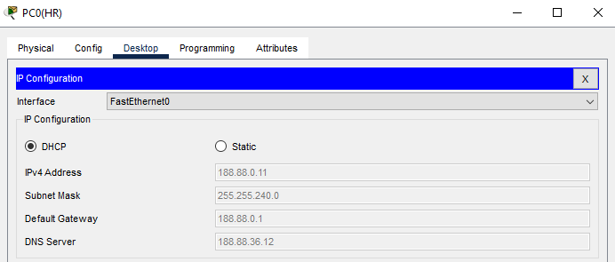
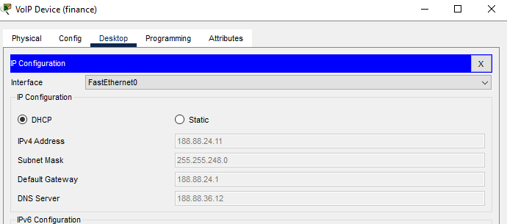
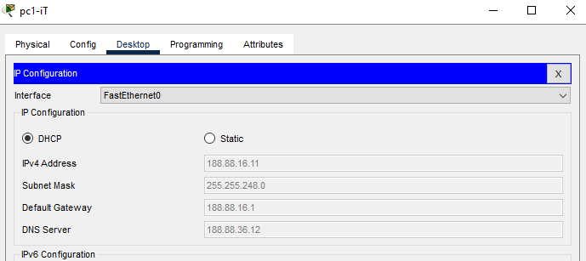
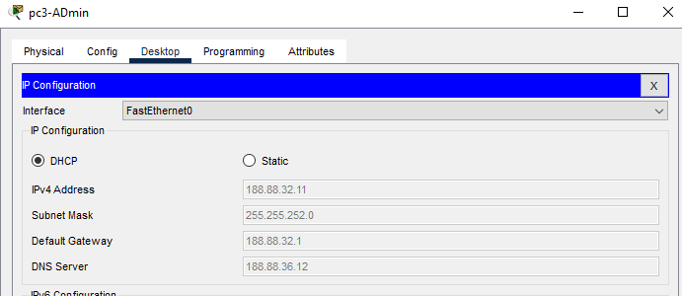
DHCP IP allocation
Sydney Branch
Hr
Finance
IT
Admin

Slide 13
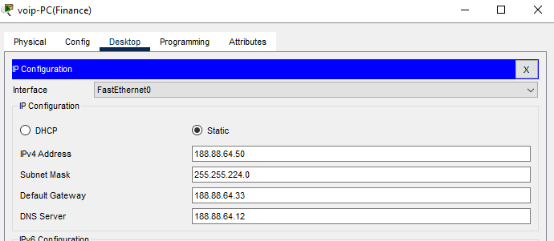
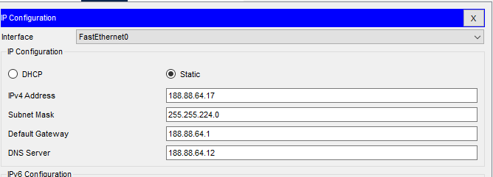
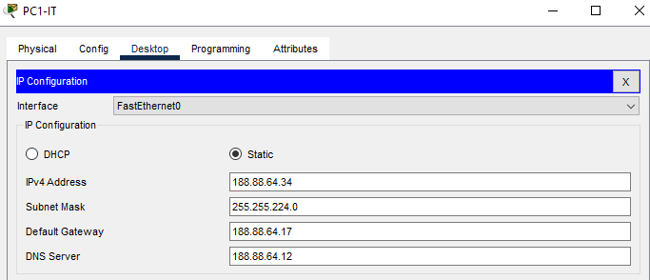
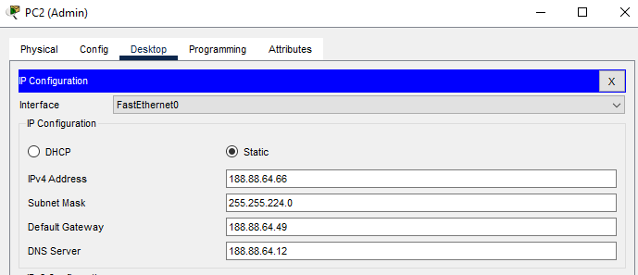
DHCP IP allocation
Melbourne Branch
Finance
Hr
Admin
IT

Slide 14
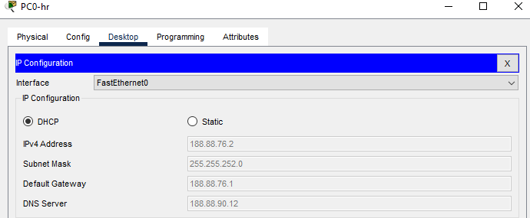
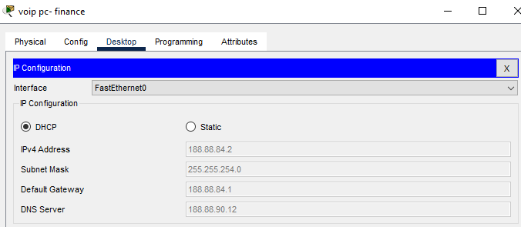
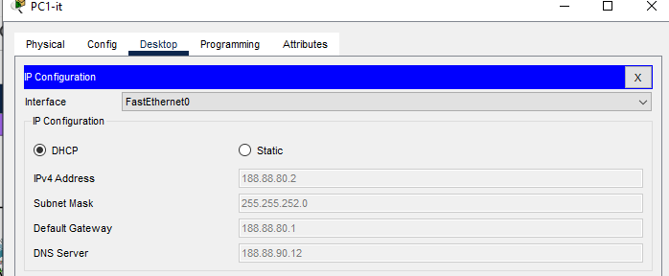
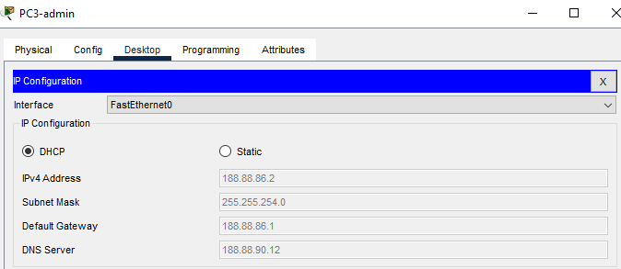
DHCP IP allocation
Brisbane Branch
Hr
Finance
IT
Admin

Slide 15
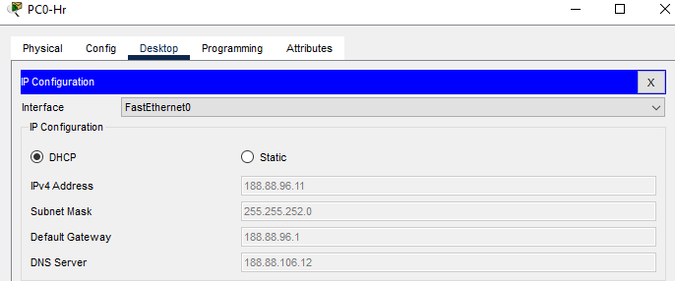
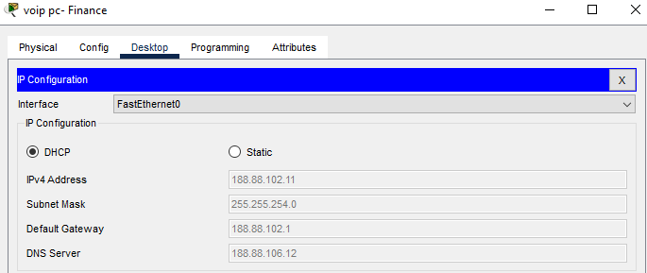
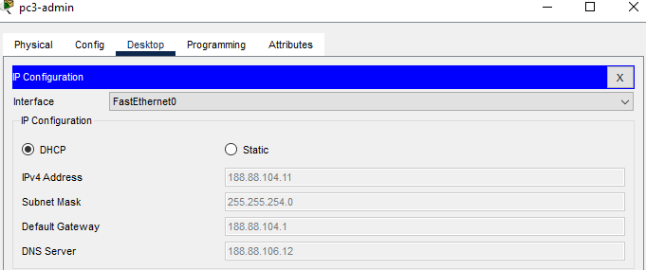
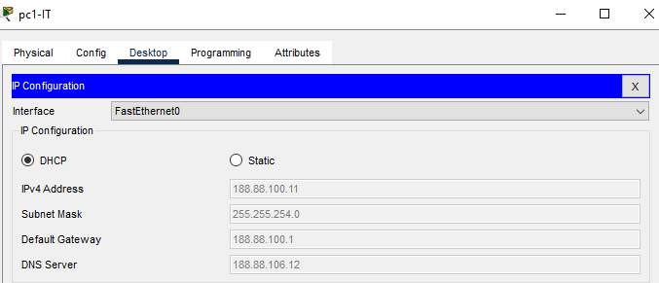
DHCP IP allocation
Hong Kong Branch
Hr
Finance
Admin
IT

Slide 16
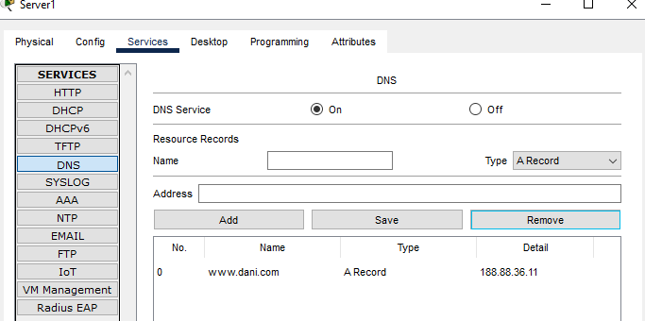
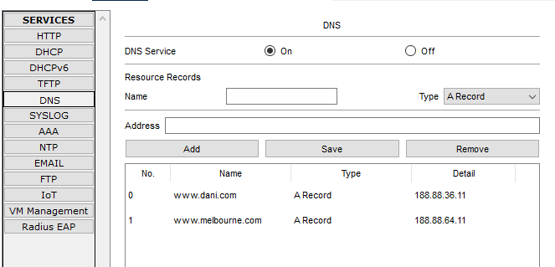
DNS Resolution
Melbourne Branch
Sydney Branch

Slide 17
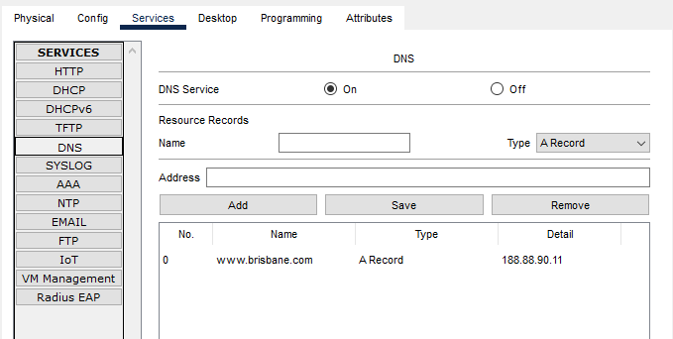
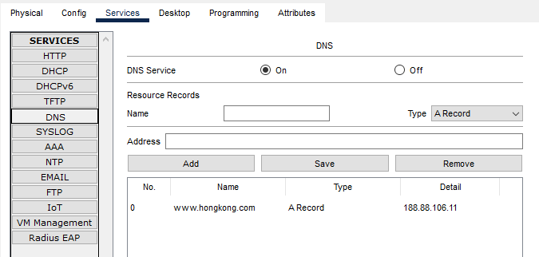
DNS Resolution
Brisbane Branch
Hong Kong Branch

Slide 18
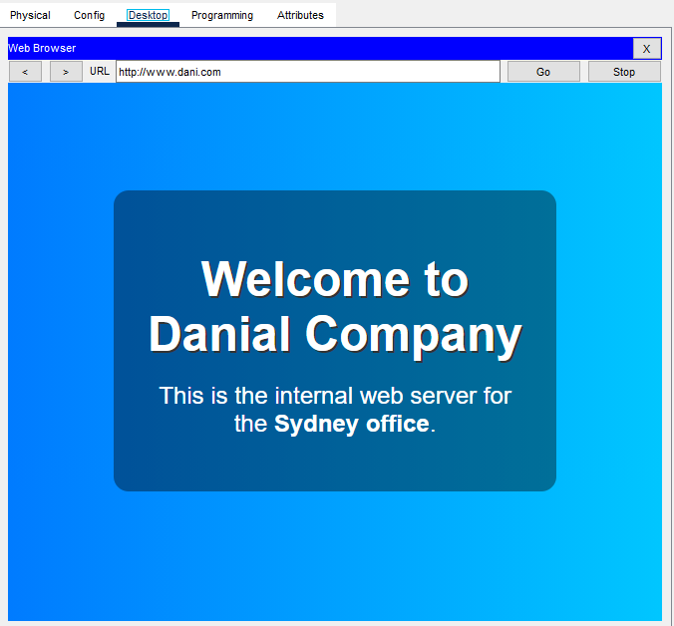
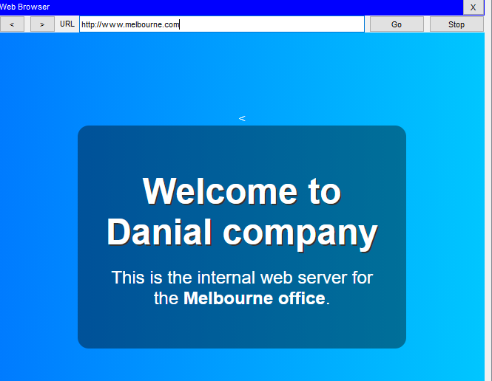
HTTP Access
Sydney Branch
Melbourne Branch

Slide 19
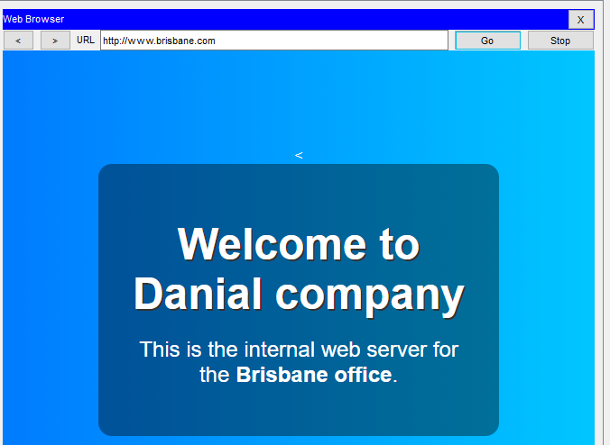
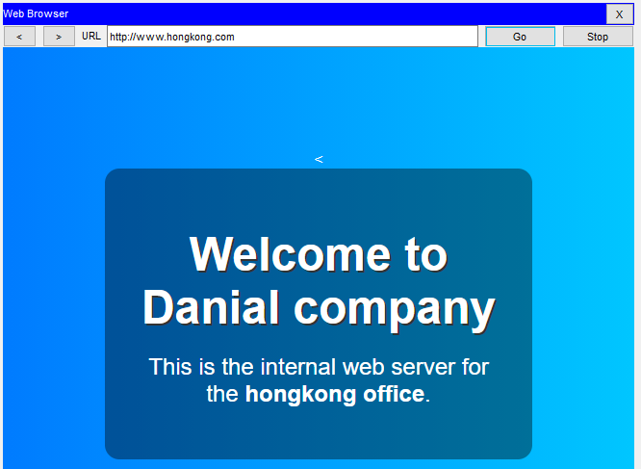
HTTP Access
Brisbane Branch
Hong Kong Branch

Slide 20
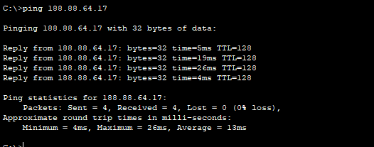
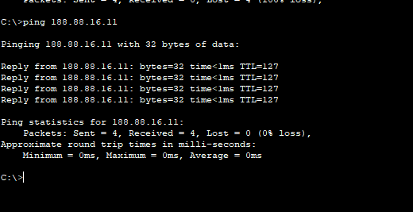
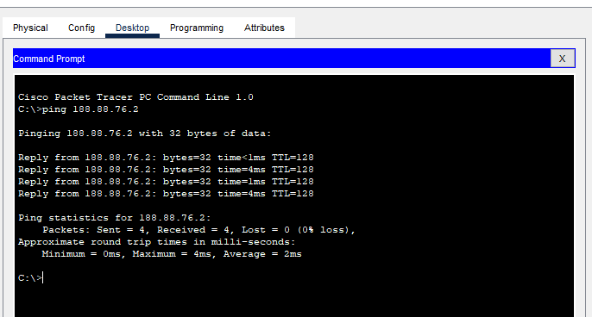
Inter-Branch Ping
Sydney to Melbourne
Melbourne to Sydney
Melbourne to Brisbane
Brisbane to Melbourne

Slide 21
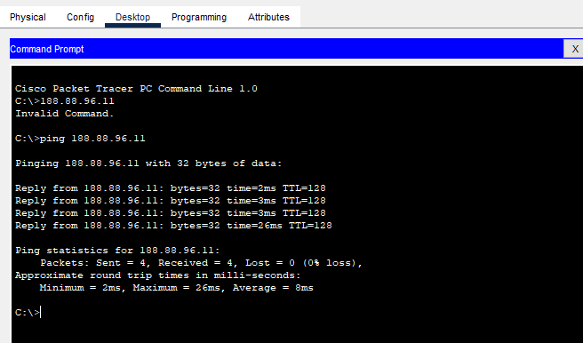
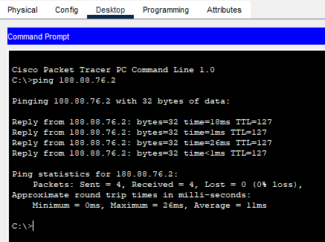
Inter-Branch Ping
Brisbane to Hong Kong
Hong Kong to Brisbane

Slide 22
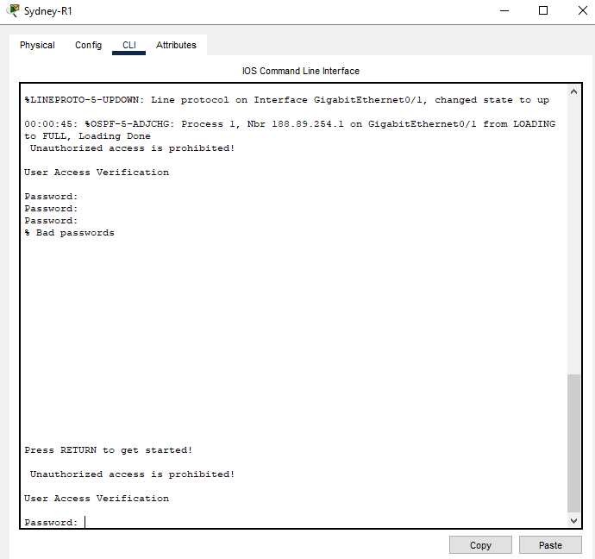
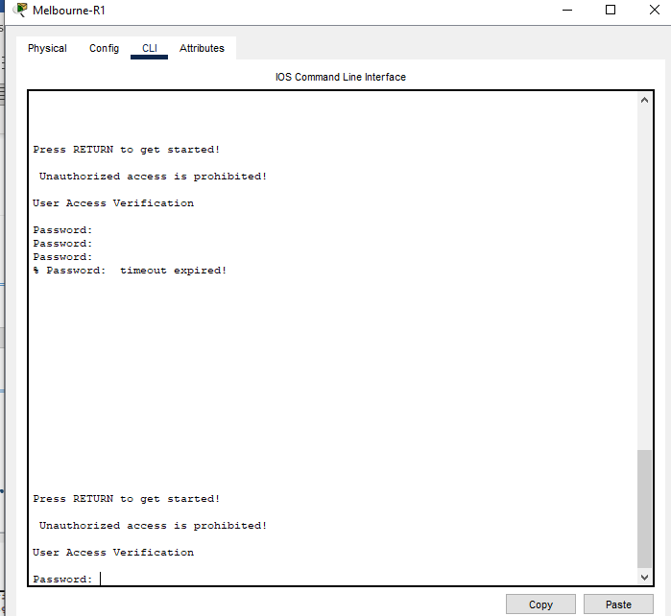
Banner on routers
Sydney Branch
Melbourne Branch

Slide 23
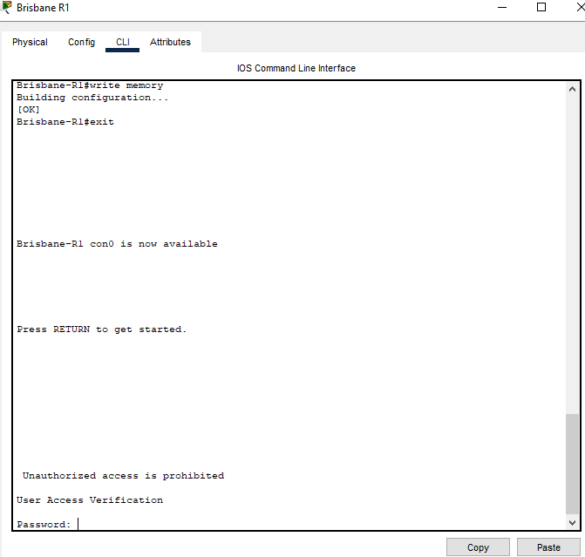
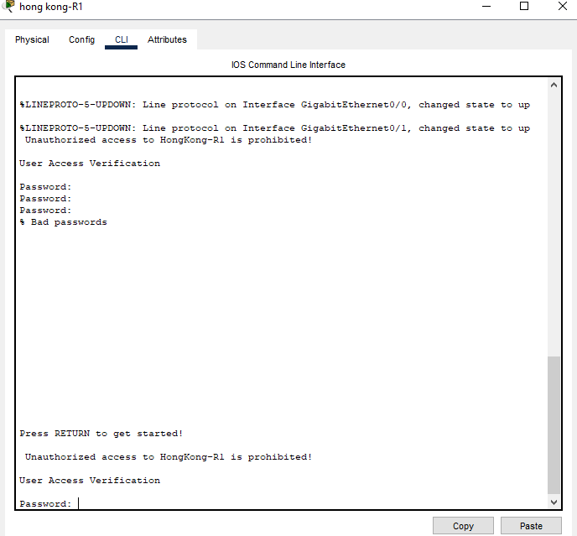
Banner on routers
Hong Kong Branch
Brisbane Branch

Slide 24


